Slide 1
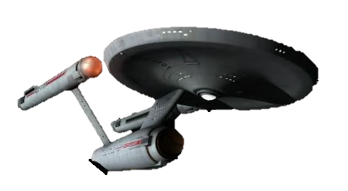
Star Trek Python : Beginner Class

Slide 2
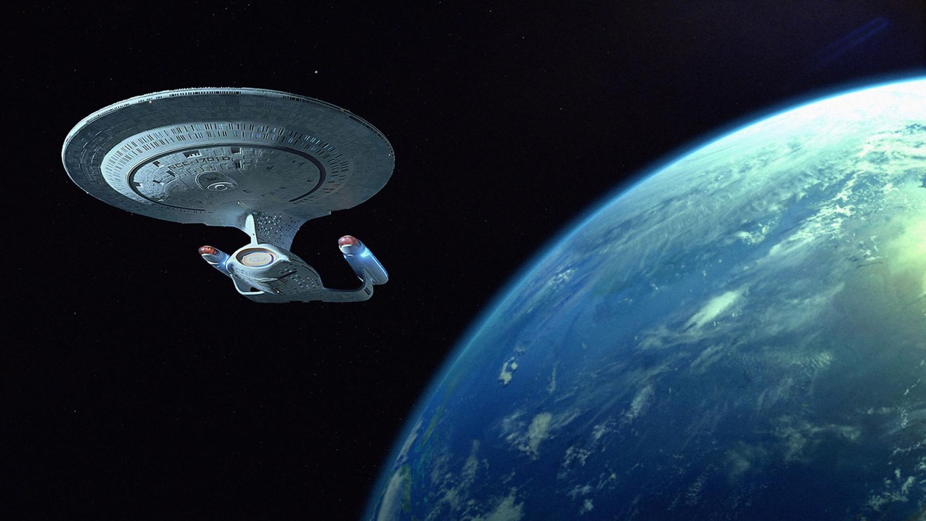

Variables are containers that have names and hold variables

Slide 3
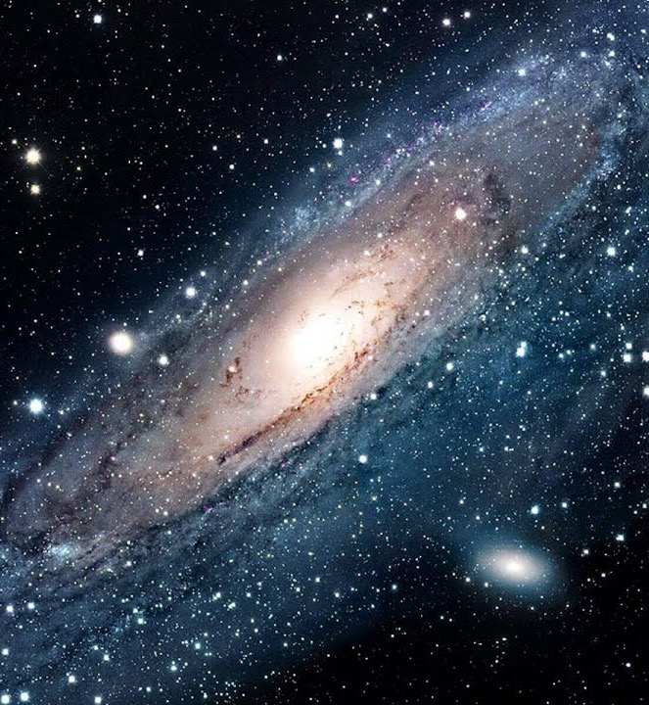
What is Python
Python is an interpreted, interactive, object-oriented programming language.
It incorporates modules, exceptions, dynamic typing, very high level dynamic data types, and classes.
Python combines remarkable power with very clear syntax. It has interfaces to many system calls and libraries, as well as to various window systems, and is extensible in C or C++.
It is also usable as an extension language for applications that need a programmable interface.
Finally, Python is portable: it runs on many Unix variants, on the Mac, and on Windows 2000 and later.

Slide 4

Variables
Variables cant start with a number
Variables cant have spaces
Variable names cant be reserved Python commands

Slide 5
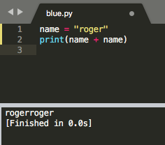
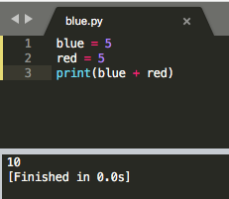
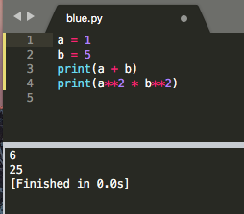

Variables can be used in different ways

Slide 6


Variables
Variables are containers that hold information

Slide 7
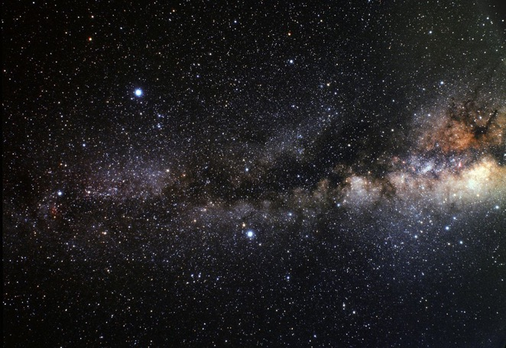
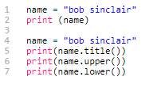
Strings and formatting
Strings are basically text (unlike numbers, code, etc)
Strings can have a single ‘’ or double “” quote
Strings can be formatted and combined

Slide 8
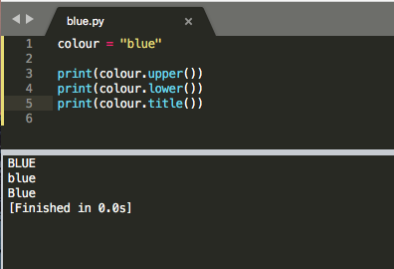
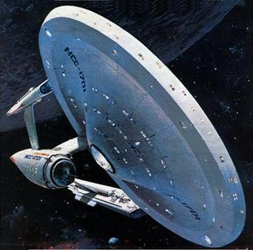

Slide 9

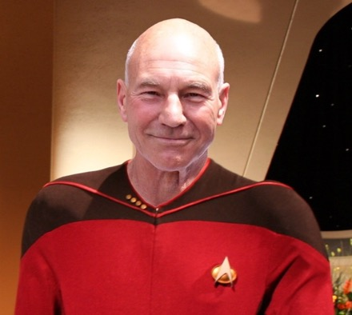
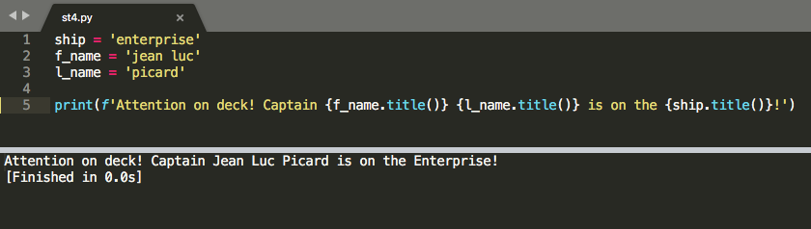
Using f-strings
(formatted strings)

Slide 10

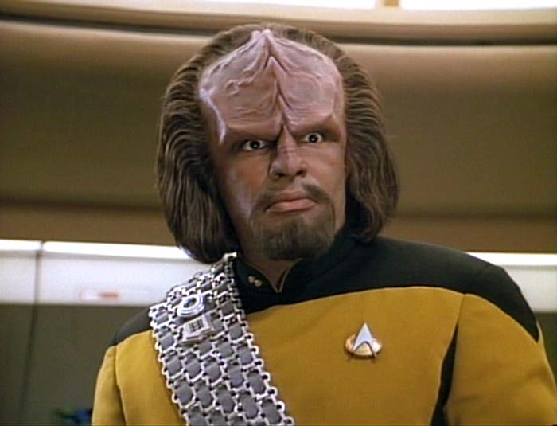
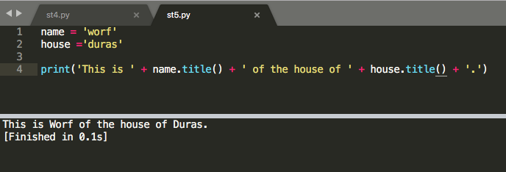
Using a join instead
of an f-string

Slide 11
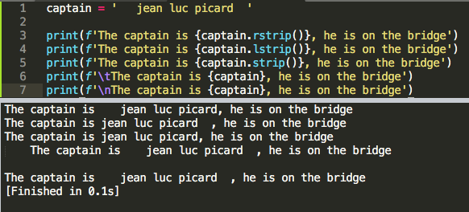
Whitespace and rstrip
\n
\t
.rstrip()
.lstrip()
.strip()

Slide 12
Integers and floats
Integers are whole numbers
Floats are fractions (numbers with a decimal)
Addition +
Subtraction –
Multiplication *
Division /
Exponents **
Order of operation

Slide 13


Integers and floats
These can be confused with strings, hence the (str) function
This is not needed when using a f-string

Slide 14

Underscore in numbers
Makes large numbers easier to read

Slide 15
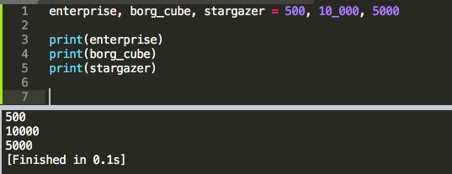
Multiple assignment

Slide 16
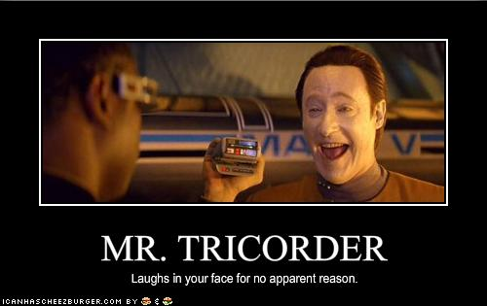
Thank you for participating!
I hope you had fun and learned
a lot of neat things about Python!

